Slide 1
Final work
Fundamentals of business process modeling

Slide 2
Basic and supporting business processes
Basic business processes:
Supply
Production
Marketing
Sales
etc .
Supporting business processes:
Accounting
Personnel management
Service desk

Slide 3
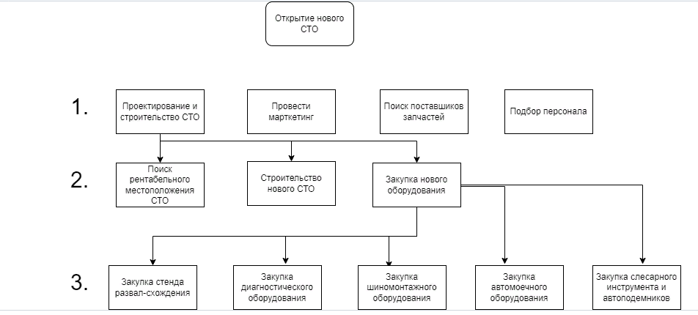
Decomposition of the process

Slide 4
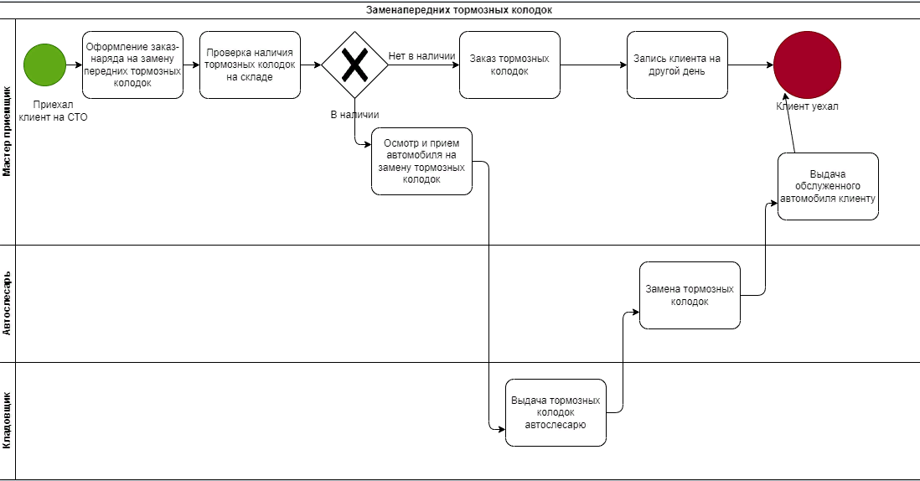
Description of the business process

Slide 5
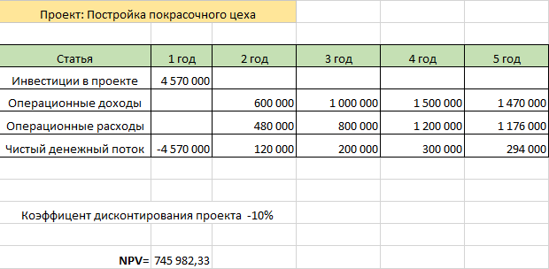
project miscalculation

Slide 6
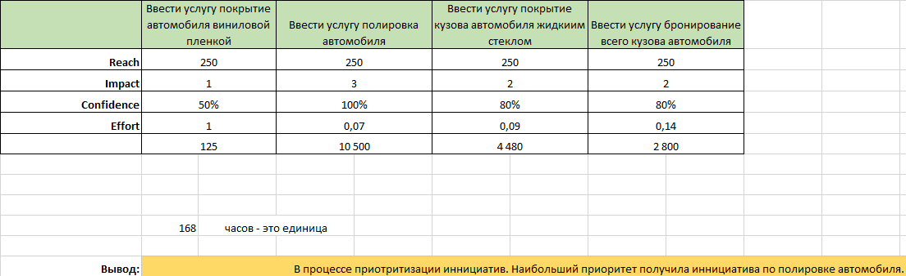
Prioritization of initiatives by the RICE method

Slide 7
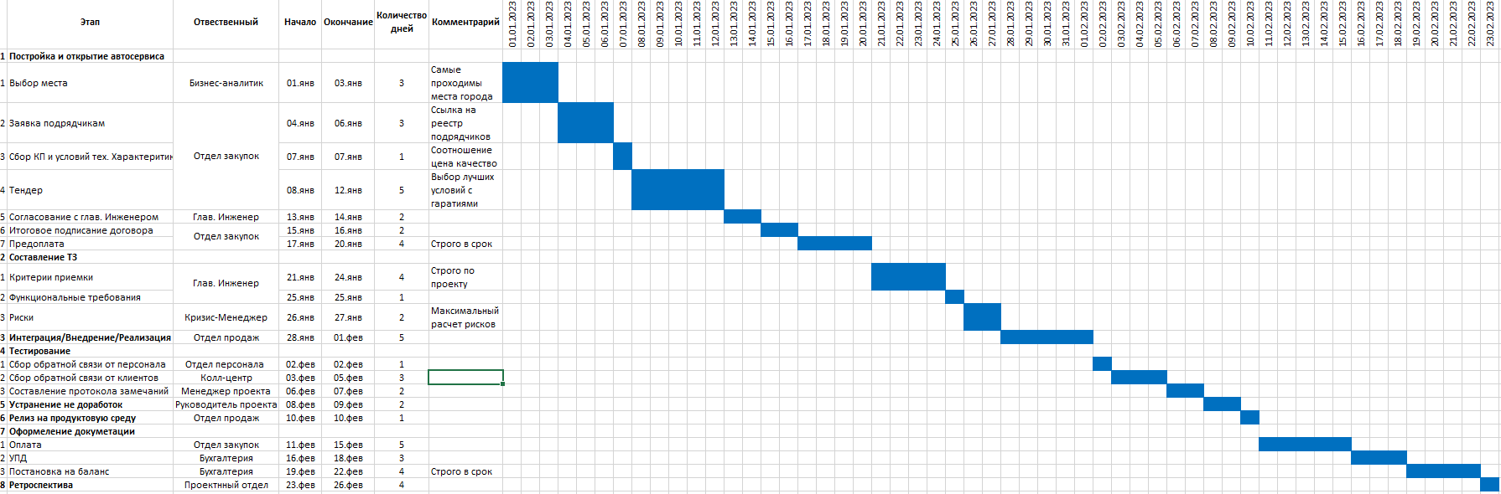
Project plan

